Slide 1
Tumor agnostic approvals
Master trials in practice
Stat4Onc, Hartford CT
27 April 2019

Slide 2
Disclosures-Nora Ku
I am an employee of Loxo Oncology, Inc., a wholly owned subsidiary of Eli Lilly and Company
I will reference the development of larotrectinib (Vitrakvi®):
VITRAKVI(tm) (larotrectnib) is being developed and commercialized by Bayer pursuant to an exclusive worldwide license from Loxo Oncology, Inc., a wholly-owned subsidiary of Eli Lilly and Company. Loxo earns royalties on sales of VITRAKVI^{® (}larotrectinib).
I am not a statistician
Notes:
These are my disclosures

Slide 3
PRESS RELEASE
On May 23, 2017, the U.S. Food and Drug Administration granted accelerated approval to pembrolizumab (KEYTRUDA, Merck & Co.) for adult and pediatric patients with unresectable or metastatic, microsatellite instability-high (MSI-H) or mismatch repair deficient (dMMR) solid tumors that have progressed following prior treatment and who have no satisfactory alternative treatment options or with MSI-H or dMMR colorectal cancer that has progressed following treatment with a fluoropyrimidine, oxaliplatin, and irinotecan.
This is the FDA’s first tissue/site-agnostic approval.
The approval was based on data from 149 patients with MSI-H or dMMR cancers enrolled across five uncontrolled, multi-cohort, multi-center, single-arm clinical trials.

Slide 4
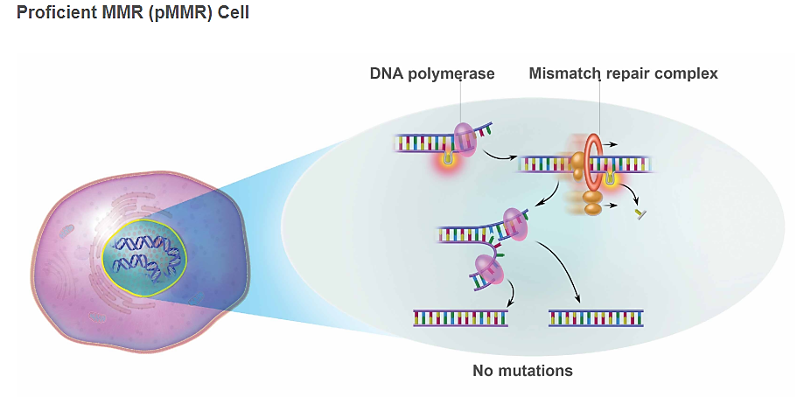
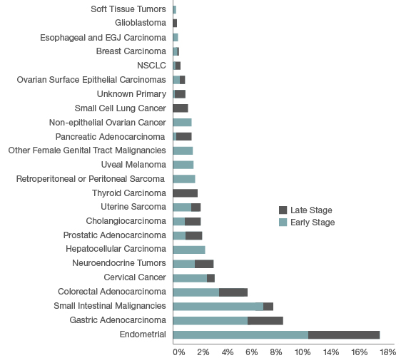
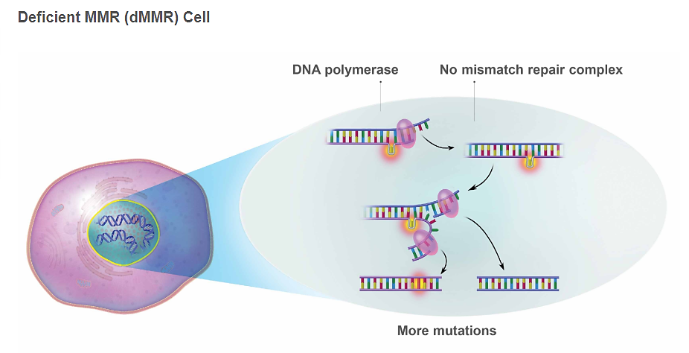
MSI-H/dMMR as a biomarker is found across tumor types
www.Keytruda.com/hcp/msi-h/about-msi-h-dmmr
Le, 2017
AAADV Workshop 2017

Slide 5
Pembrolizumab MSI-H approval dataset: 15 tumor types evaluated in 5 single arm studies including 1 basket trial
KEYNOTE-016
IIT
CRC and other cancers
MSI /dMMR status determined by prospective local or central PCR or IHC (n=135) or retrospective central PCR (14)
Primary endpoint
objective response rate by blinded ICR (RECIST 1.1)
Dosing
Single-agent pembrolizumab
200 mg q 3 weeks OR 10 mg/kg q 2 weeks
Maximum 24 months of treatment
n=58
KEYNOTE-164
CRC
n=61
149 patients with MSI-H/dMMR solid tumors
KEYNOTE-012
Gastric, bladder, TNBC
n=6
KEYNOTE-028
Esophageal, biliary, breast, endometrial, CRC
n=5
KEYNOTE-158
MSI-H/dMMR non CRC
Rare tumor non-CRC
n=19
n=149
ORR | 39.6% (BICR)
Med DOR (ms) | NR
CRC-=colorectal cancer
Keytruda USPI, 2017

Slide 6
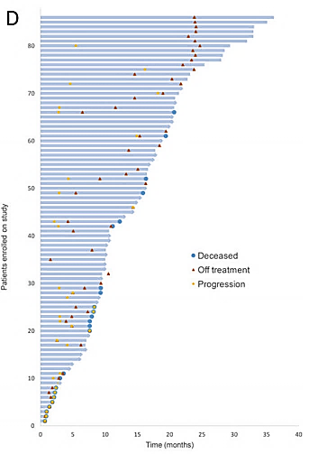
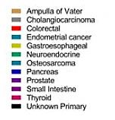
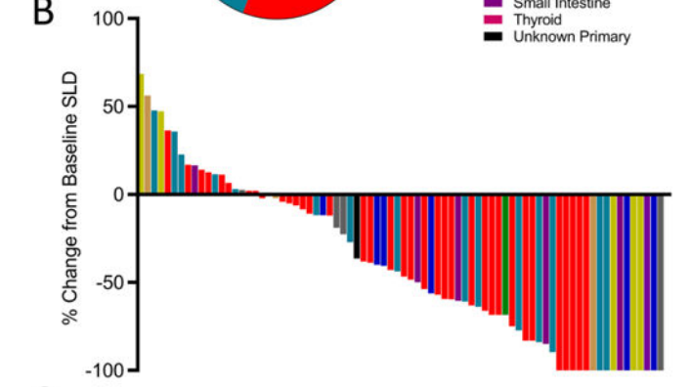
Keytruda® effects across MSI-H tumor types
Duration of Response
Le et al. Science 2017; 357:409

Slide 7
PRESS RELEASE
On November 26, 2018, the Food and Drug Administration granted accelerated approval to larotrectinib (VITRAKVI, Loxo Oncology Inc. and Bayer) for adult and pediatric patients with solid tumors that have a neurotrophic receptor tyrosine kinase (NTRK) gene fusion without a known acquired resistance mutation, that are either metastatic or where surgical resection is likely to result in severe morbidity, and who have no satisfactory alternative treatments or whose cancer has progressed following treatment.
This is the second tissue-agnostic FDA approval for the treatment of cancer.
Approval was based on data from three multicenter, open-label, single-arm clinical trials: LOXO-TRK-14001 (NCT02122913), SCOUT (NCT02637687), and NAVIGATE (NCT02576431).

Slide 8
TRK biology in normal development and in cancer
Neurotrophin family of receptors
TRK fusions
TRKA (NTRK1) | Pain, thermoregulation
TRKB (NTRK2) | Movement, memory, mood, appetite, body weight
TRKC (NTRK3) | Proprioception
Ligand binding domain (LBD) replaced by 5’ fusion partner
Drives overexpression and ligand-independent activation
NTRK1/2/3
Promoter
5’ partner
LBD
kinase domain
Tyr
Tyr
ERK
5’ partner
NTRK kinase domain
Tyr
Tyr
Tyr
Tyr
AKT
5’ partner
NTRK kinase domain
5’ partner
NTRK kinase domain
TRK uncommonly expressed in normal tissues or cancer
Fusion drives abnormally high expression and activation of TRK kinase domain

Slide 9
TRK fusions are found in diverse cancer histologies in
adults and children
Notes:
The second source of heterogeneity is tumor histology.

Slide 10
Larotrectinib TRK fusion cancer primary dataset: 12 tumor types evaluated in 3 single arm studies including 1 basket trial
TRK fusion status determined by local CLIA (or similarly accredited) laboratories
Primary endpoint
Best objective response rate (RECIST 1.1)
Secondary endpoints
Duration of response
Progression-free survival
Safety
Dosing
Single-agent larotrectinib, administered predominantly at 100 mg BID continuously
Treatment beyond progression permitted if patient continuing to benefit
Primary
Adult phase I
Age ≥18 years
Advanced solid tumors
n=8
55 patients with TRK fusion solid tumors
SCOUT: pediatric phase I/II
Age ≤21 years
Advanced solid tumors
n=12
NAVIGATE: adult/adolescent phase II ‘basket’ trial
Age ≥12 years
Advanced solid tumors
TRK fusion cancer
n=35
n=55
ORR | 75% (BICR)
Med DOR (ms) | NR
BID, twice-daily; CLIA, clinical laboratory improvement amendments;
RECIST, Response Evaluation Criteria In Solid Tumors
Drilon et al. NEJM; 2018; 378:731

Slide 11
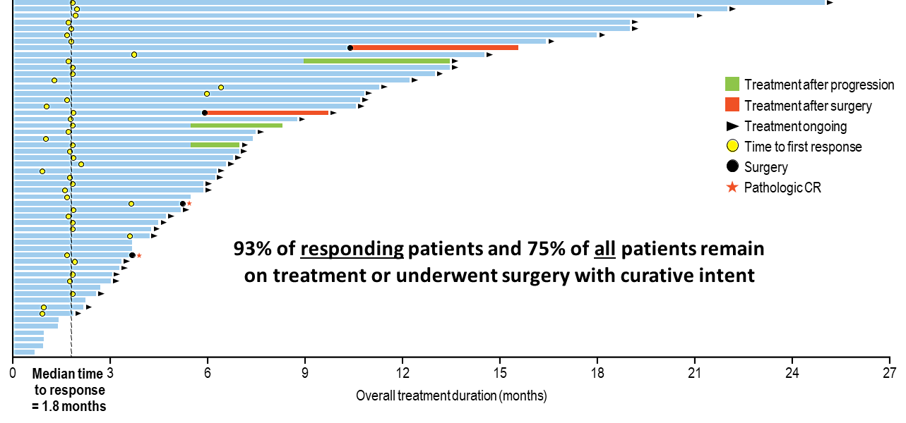
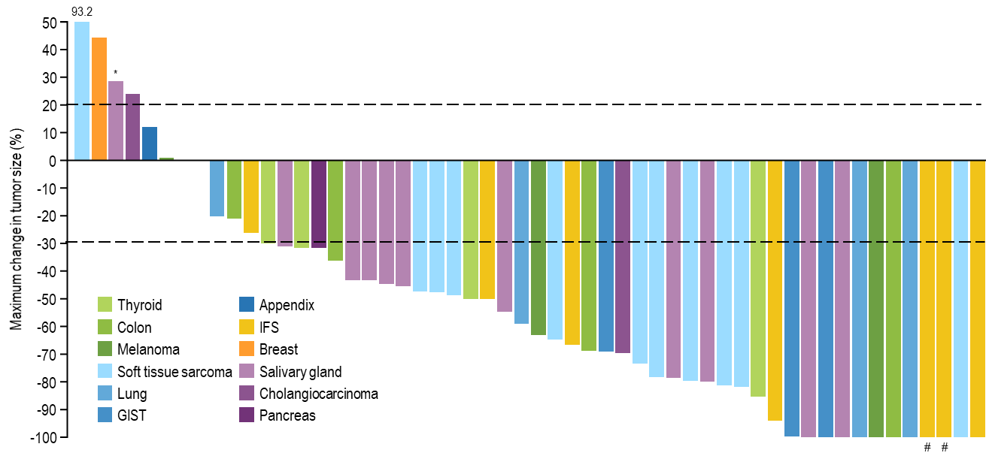
Efficacy of larotrectinib in TRK fusion cancers: ORR by IRC Primary NDA dataset
 | Patients with confirmatory response data available (n=50)
Objective response rate (95% CI) | 76% (62–87%)
Partial response | 64%
Complete response | 12%
Stable disease | 12%
Progressive disease | 12%
Median onset of response: 1.8 ms
Hyman, ASCO 2017; LBA2501
Drilon et al. NEJM 2018; 378:371
*Patient had TRK solvent front resistance mutation (NTRK3 G623R) at baseline due to prior therapy; #Pathologic CR
Note: One patient not shown here. Patient experienced clinical progression and no post-baseline tumor measurements were recorded.

Slide 12
Tumor agnostic approvals:
Biomarker based
Therapeutic target present across multiple tumor types
High ORR and generally consistent across tumors
Durable responses
Parallel development in adults and children
Clinical considerations for tumor agnostic vs tumor specific
Protocol considerations: capturing multiple tumor types
Operational challenges: investigator and site engagement
Target identification: Tissue sampling and biomarker detection
Notes:
Lead in to Drugs

Slide 13
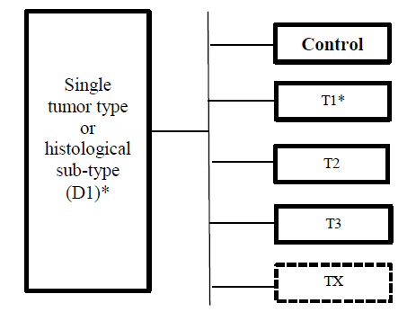
“Master Protocols”
Basket trial:
Investigational drug across tumor types
Umbrella trial:
Investigational drug in a single tumor type
Hyman et al NEJM 2015; 373:726

Slide 14
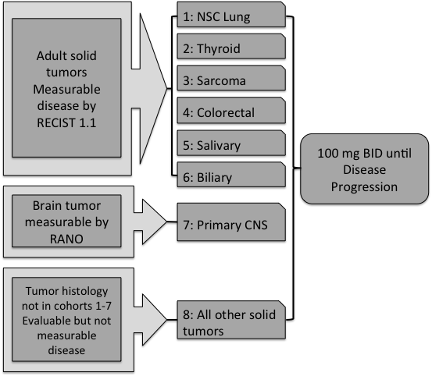
Larotrectinib phase 2 basket study (NAVIGATE)
NAVIGATE: Larotrectinib Phase 2 Basket Study
Primary endpoint
Best overall response of confirmed CR or PR as measured by RECIST 1.1 or RANO for each tumor specific disease cohort
Included in Secondary endpoints
Duration of response for each tumor specific disease cohort
NTRK fusion (+)
For each cohort: Simon 2-stage design
Stage 1: ≥ 1/7
Stage 2: ≥ 4/18
For cohort 8: new cohort for tumor types
enrolling at least 7 with application of Simon
2-stage
Notes:
Following the publication, we decided to initiate a global phase 2 basket study. That occurred in October of 2015, 7 months after enrolling the first TRK fusion patient
This study remains open and actively recruiting in a number of countries

Slide 15
Protocol design: Eligibility elements
Age limitations | 12 years and older No upper age limit
CNS metastases | Allowed if stable
Labs | No preclinical heme toxicity thus no parameters specified
Prior treatment specification | Unspecified by lines of prior therapy Specified as appropriate for tumor type and co-morbidities
Biomarker detection | “NTRK1, NTRK2, or NTRK3 gene fusion, identified through molecular assays as routinely performed at CLIA or other similarly-certified laboratories”.

Slide 16
Larotrectinib (Vitrakvi^{®)}: Primary analysis set agreed upon by multiple regulatory authorities*
TRK fusion status determined by local CLIA (or similarly accredited) laboratories
Primary endpoint
Best objective response rate (RECIST 1.1)
Secondary endpoints
Duration of response
Progression-free survival
Safety
Dosing
Single-agent larotrectinib, administered predominantly at 100 mg BID continuously
Treatment beyond progression permitted if patient continuing to benefit
Adult phase I
Age ≥18 years
n=8
Initial 55 patients with TRK fusion solid tumors eval by RECIST
SCOUT: pediatric phase I/II
Age ≤21 years
n=12
NAVIGATE: adult/adolescent phase II ‘basket’ trial
Age ≥12 years
n=35
n=55
*Primary Analysis Set
Agreed to by FDA, MHRA, MPA, BfArM

Slide 17
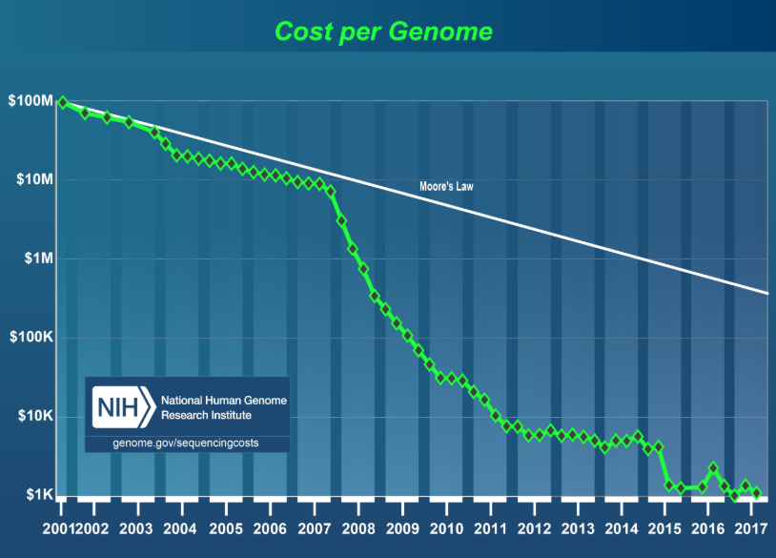
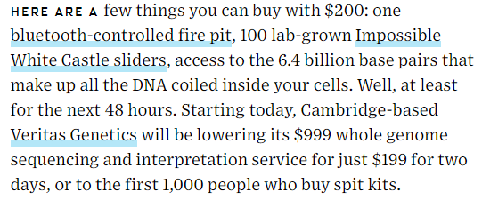
“Personalized Medicine” by NGS: accessible to all?
11.19.18
Human Genome Project 2003
Notes:
The biggest factor in this shift has certainly been the cost, and thus the accessibility, of genomic sequencing..
We have all heard the initial sequencing of the human genome cost $1-2Bn.
Now , one can find offerings of less than $1000 which includes the bioinformatics review and interpretation.

Slide 18
Molecular “tail”: is study specific testing practical for rare targets?
Head: TP53, KRAS, p16, MYC
Patient samples (%)
Long tail: ALK, ROS1, TRK, RET
1,579 unique gene alterations
Frequency of reported alterations in solid tumors, N=2112
Number Needed to Screen =
1/ (% biomarker-positive X fraction trial eligible x fraction who will consent)
Example:
NTRK fusion= 1/(0.01 X 0.9 X 0.8)
~139 patients screened/1 patient studied
1/ (0.001 X 0.9 X 0.8)
~1389 patients screened/1 patient studied
Central testing to find patients
VS
Local testing in clinical practice
Reference: Frampton et al. Nat Biotechnol. 2013 November ; 31(11): 1023–1031. doi:10.1038/nbt.2696.
Notes:
The application of molecular profiling to large numbers of patient tumor samples has revealed a key therapeutic paradox.
85% of all hotspot mutations affect < 5% of any cancer type in which they are found
Chang Nat Biot 2016 Feb;34(2):155-63

Slide 19
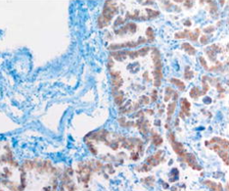
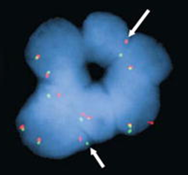
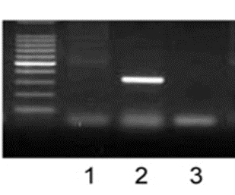
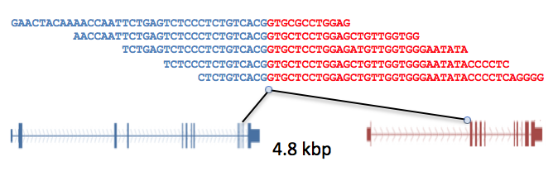
Identification by Biomarker: testing considerations
$
Ease & access
IHC, Immunohistochemistry
Detects protein expression, which may be attributable to a fusion event
FISH, Fluorescence In Situ Hybridization
Detects gene rearrangements in DNA that may generate a fusion transcript
RT-PCR, Reverse Transcription Polymerase Chain Reaction
Detects known fusion transcripts in RNA
Detects 5’/3’ imbalance as a fusion signature, but can not determine novel partner
NGS, Next-Generation Sequencing
Detects known and novel fusions with arbitrary breakpoints in DNA or RNA
Exact capabilities depend on enrichment strategy
$$$$
Notes:
Genomic complexity leads to testing challenges to identify targets of interest easily, with reproducibility, cost effectiveness.

Slide 20
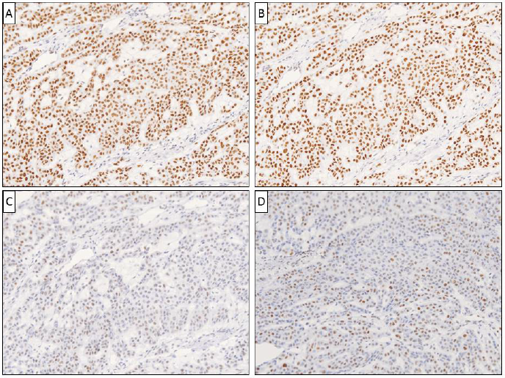
Keytruda®: finding MSI-H/dMMR
-IHC is a simple test and widely available
MLH1
PMS2
MSH2
MSH6
dMMR when at least one of four MMR proteins are absent

Slide 21
Larotrectinib (Vitrakvi^{®)}: finding NTRK fusions.
?What is the best test when study drug is effective…
50
93.2
NTRK1
40
NTRK2
30
*
NTRK3
20
regardless of (NTRK) gene involved?
10
0
-10
-20
Maximum change in tumor size (%)
-30
-40
-50
-60
-70
-80
-90
-100
#
#
50
93.2
NTRK1
LMNA
TPM3
TPR
CTRC
PDE4DIP
IRF2BP2
SQSTM1
PPL
TRIM63
40
NTRK2
STRN
…or regardless of fusion partner?
30
*
NTRK3
ETV6
TPM4
20
10
0
-10
-20
Maximum change in tumor size (%)
-30
-40
Drilon et al NEJM 2018; 378:371
-50
*Patient had TRK solvent front resistance mutation (NTRK3 G623R)
at baseline due to prior therapy
-60
#Pathologic CR
-70
-80
-90
-100
#
#

Slide 22
Detection of the target depends on the test
Typical question: “how big is your panel?”
Better question: “how good is your panel?”
Somatic or germline?
DNA +/or RNA?
Exome or WGS?
What does the assay cover?
mutations
gene fusions?
what genes?
How much tissue is required?
What tissue:
blood vs tissue?
Fresh vs FFPE
70 genes | 324 genes
Blood test | Tissue test
Gene Mutations | Gene Mutations
Notes:
For the most detailed test, the most expensive option , one would assume that the term “NGS” is a uniform test request with across labs.
In clinical oncology and drug development Is a panel testing 600 genes better than one that only tests 60 genes?

Slide 23
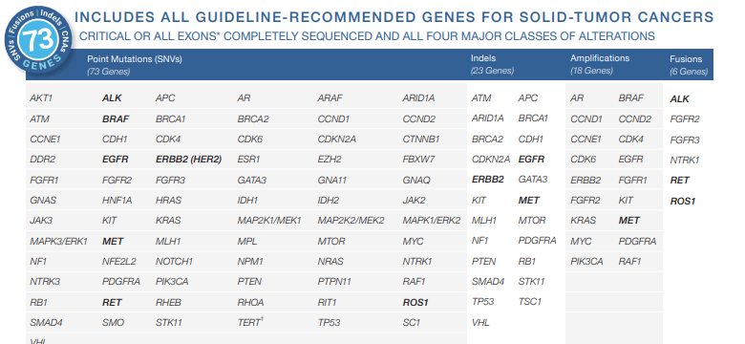
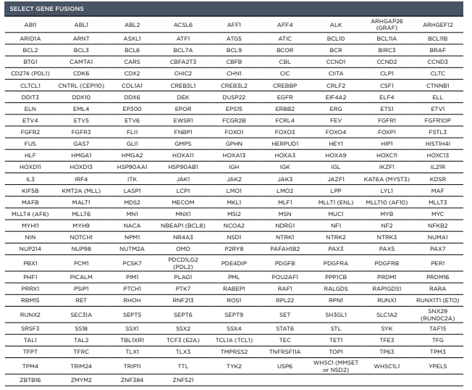
Nuances of the tests may not be appreciated
What do clinicians understand?
Foundation panel is bigger but Guardant panel uses blood
Guardant panel only detects NTRK 1 fusions
(In progression setting:
Guardant panel detects TRK kinase mutations
Foundation panel does not)
Notes:
For the most detailed test, the most expensive option , one would assume that the term “NGS” is a uniform test request with across labs.
In clinical oncology and drug development Is a panel testing 600 genes better than one that only tests 60 genes?

Slide 24
Other considerations for biomarker testing
IDE considerations
A new assay for every new target?
Integration into existing clinical paradigms?
Cost?
How are these used in the clinic?
Tissue sampling? Serial? One time?
Tissue requirements? X slides/X ng tumor

Slide 25
Operational considerations

Slide 26
Traditional studies: histology and organ of origin specific
Tumor agnostic studies: histology and organ of origin non-specific
Academic vs Community
Disease types specified in trial
Site disease focused clinics
Biomarker usage and implementations
Tissue handling by specialty pathology
Impact of subspecialization on patient id
Investigator selection
Academic vs Community
Multiple disease types to be treated in trial
Engage multiple site disease clinics or the trial
Awareness of biomarker and testing across disease types
Engage pathologists across tumor types
Engage staff /trial administration at tumor specific clinics
Engaging investigators across tumor types

Slide 27
For rare molecular targets, study site number projections are affected by identified primary population and timeline
Estimated enrollment
Estimate 1-2 pt PER SITE per year
Target primary population n=30
% of total patient population=50%
Total enrollment=60
Target primary population n=40
% of total patient population=35%
Total enrollment =128
Examples
12 months | 1 pt/site | 60 sites
12 months | 2 pt/site | 30 sites
18 months | 1 pt/site | 45 sites
24 months | 2 pt/site | 30 sites
12 months | 1 pt/site | 128 sites
12 months | 2 pt/site | 64 sites
18 months | 1 pt/site | 86 sites
24 months | 2 pt/site | 64 sites

Slide 28
Pediatric development
A rewarding population

Slide 29
Observation #1: TRK fusions are found in diverse cancer histologies in adults and children
Notes:
For larotrectinib: early observations ==histologies in adults and children

Slide 30
Observation #2: Pediatric cancers have a higher incidence of NTRK fusion (+) than adult cancers
EsObservationtimated frequency of TRK fusions across tumor types
≤5%
5%-25%
≥75%
CNS
Astrocytoma¹
Low-grade glioma²
Glioblastoma³
GI
Colorectal cancer^{2,4}
Cholangiocarcinoma⁵
Pancreatic cancer⁶
Head and Neck
Squamous cell carcinoma²
Lung
Adenocarcinoma^{2,7}
Large cell neuroendocrine carcinoma⁸
Other
Acute myeloid leukemia⁹
Breast-invasive carcinoma²
Melanoma²
Sarcoma²
Congenital mesoblastic nephroma^{10,11}
Recurrent papillary thyroid cancer¹²
Pontine glioma¹³
Spitzoid melanoma¹⁴
Pediatric and young adult soft tissue sarcomas¹⁵
Pan-negative gastrointestinal stromal tumors (GIST)¹⁶
Mammary analogue secretory carcinoma (MASC) of the salivary gland¹⁷
Secretory breast carcinoma¹⁸
Infantile fibrosarcoma¹⁹
References: 1. Jones DT, et al. Nat Genet. 2013;45:927-934. 2. Stransky N, et al. Nat Commun. 2014;5:4846. 3. Kim J, et al. PLoS One. 2014;9:3. 4. DeBraud F, et al. ASCO. 2014 (abstr 2502). 5. Ross JS, et al. Oncologist. 2014;19: 235-242. 6. Bailey P, et al. Nature 2016;531:47-52. 7. Vaishnavi A, et al. Nat Med. 2013;19:1469-1472. 8. Fernandez-Cuesta L, et al. AACR. 2014 (abstr 1531). 9. Kralik JM, et al. Diag Path. 2011;6:19. 10. Argani P, et al. Mod Path. 2000;13:29. 11. Rubin BP, et al. Amer J Path. 1998;153:1451-1458. 12. Leeman-Neill RJ, et al. Cancer. 2014;120:799-807. 13. Wu G, et al. Nat Genet. 2014;46:444-450. 14. Wiesner T, et al. Nat Commun. 2014;5:3116. 15. Morosini D, et al. ASCO. 2015 (abstr 11020). 16. Brenca M, et al. J Path. 2016;238:543-549. 17. Bishop JA, et al. Hum Pathol. 2013;44:1982-1988. 18. Tognon C, et al. Cancer Cell. 2002;2:367-376. 19. Bourgeois JM, et al. Am J Surg Pathol. 2000;24:937-946.
Notes:
Observation #2: highest frequency of TRK fusions in pediatric tumors.
Thus pedi development crucial part of the development program.
On the Left, we see that TRK fusions are relatively uncommon in very common cancers (colorectal, pancreatic, adenocarcinoma of the lung).
These are cancer that are known to have a variety of genetic changes
While a TRK fusion lung cancer probably has no other oncogenic alteration, lung cancer in general can have many different oncogenic alterations
And on the Right, we see that TRK fusions are relatively common in very Uncommon cancer (Infantile fibrosarcoma, mammary analogue secrectry carconima of the salivary gland, secretory breast cancer). In these tumors, TRK fusion is the sole genetic alteration

Slide 31
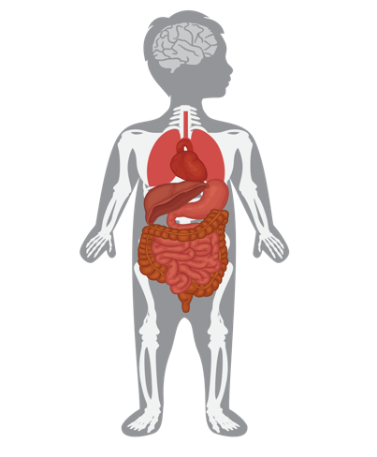
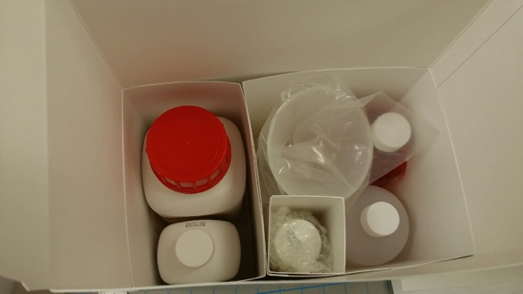
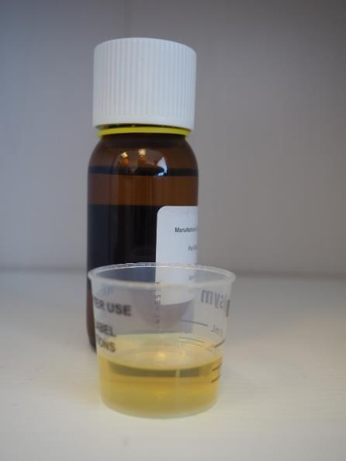
Unmet need in TRK fusion cancers and evolving clinical solutions
Treatment of children: Formulation, formulation, formulation
Need to dose children who cannot swallow a capsule
Compassionate Access
Liquid formulation
Kit formulation
Explore a pediatric study
Notes:
In addition, we wanted to open a pediatric trial. That would require a formulation for children that could not swallow capsules based on the young age of diseases that were reported to have a TRK fusion.
A liquid formulation was slated to be available in April 2016.
However, we knew we needed to have a backup in place, and so we developed a Kit, whereby Loxo Oncology could, if needed, send all of the ingredients to a clinical trial site and have the pharmacist compound the solution.
FYI: we held an advisory board,
We received feedback such as “inhibiting TRK in a child is a bad idea, Chemotherapy will cause less developmental issues than inhibiting TRK”
And, my personal favorite: These patients DO NOT exist

Slide 32
SCOUT: Phase 1/2 Pediatric basket trial
SCOUT: Trial design
Primary endpoint
Phase 1: To determine the safety of oral larotrectinib (LOXO-101), including dose-limiting toxicity (DLT), in pediatric patients with advanced solid or primary central nervous system (CNS) tumors.
Phase 2: To determine the overall response rate (ORR) as determined by an independent radiology review committee and measured by RECIST 1.1 or RANO criteria, as appropriate.
Secondary endpoints
Duration of response
Phase 1/2
Refractory advanced solid and primary CNS tumors
100 mg/m2 (max 100 mg) BID
Infantile fibrosarcoma
Other extra-cranial, TRK fusion positive
Primary CNS, TRK fusion positive

Slide 33
High response rate in children with TRK fusions: presented to ASCO 2017
Non-TRK fusion
TRK fusion
50
91.9
40
30
20
10
0
-10
-20
Maximum change in tumor size (%)
-30
-40
-50
-60
-70
-80
-90
-100
#
#
Note: 3 Non-NTRK fusion patients not shown due to clinical disease progression without post-baseline tumor measurements. 4 TRK fusion patients not shown due to having non-measurable disease (n=2) or no disease assessments yet/continuing treatment (n=2). #Pathologic CR
Laetsch, ASCO 2017; abs10510
Laetsch et al Lan Onc 2018; http://dx.doi.org/10.1016/S1470-2045(18)30119-0
33

Slide 34
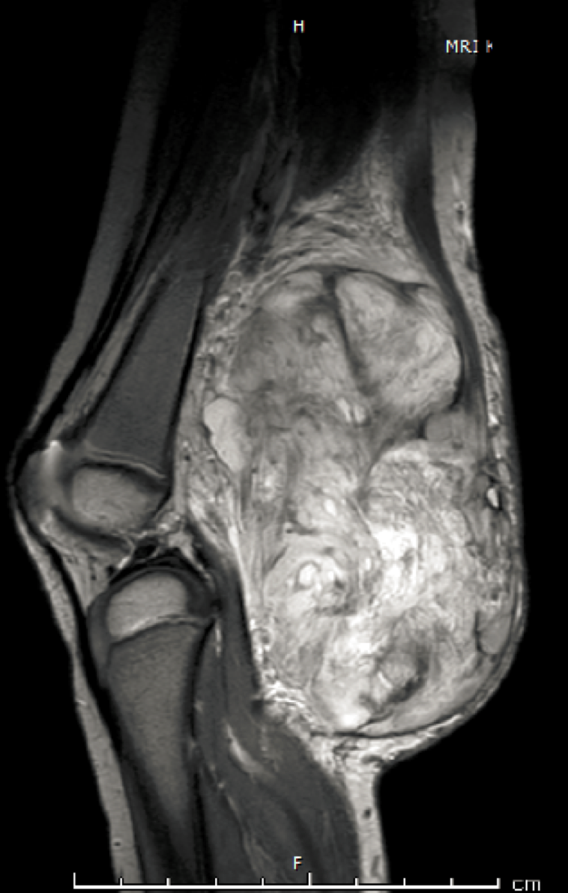
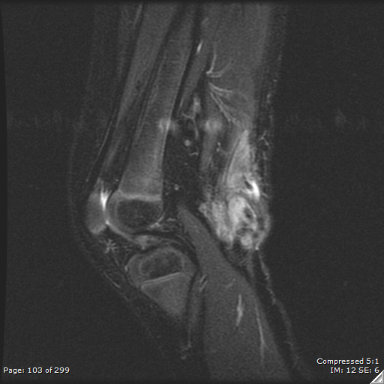
ETV6-NTRK3 infantile fibrosarcoma patient
2 yo girl with infantile fibrosarcoma
2 cycles of vincristine/ actinomycin-D/ cyclophosphamide → progression → leg amputation was only alternative option
4 cycles larotrectinib → referred for surgery
Pathologic complete response with clear margins
No functional deficit post-surgery
No adverse events reported
Baseline
Cycle 3
Kummar S and Lassen U. Targeted Oncology 2018; https://doi.org/10.1007/s11523-018-0590-1
DuBois S et al. Cancer 2018; 124:4241
Courtesy of L. Mascarenhas, CHLA

Slide 35
New targeted drug approvals in children
Peds
Imatinib
Sirolimus
everolimus
larotrectinib
pembrolizumab
Adults, age 18+
58 including IO
Challenges
Most trials exclude patients age <18
“Rare cancers” are not a economic priority for industry (0.01% of adult incidence)
Lack of funding for pediatric trials
Rare single target pathophysiology—economic investment?
Fear of “harm” to young patients especially targeted therapy

Slide 36
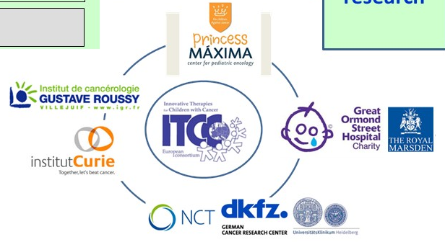
Pediatric sequencing initiatives OUS: “Actionable” alterations identified in up to 70% of pediatric oncology patients
iTHER
AM-PAED
3000 exomes at relapse by 2019
Notes:
NGS initiatives in Oncology are different for adults vs children
Overall sequencing initiatives, not target focused.
But emphasize: sequencing is becoming more widespread and rare targets becoming increasingly identified.

Slide 38
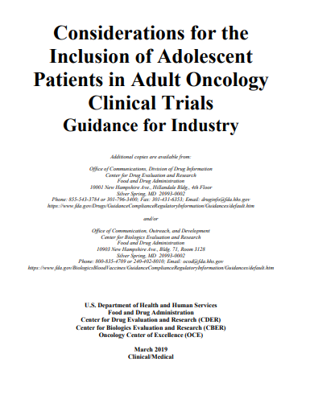
New drug assessments in children should be a part of development in the age of precision medicine
Suggested Solutions
Use adult safety profile and refine protocol to manage specific side effects
Use adult phase 1 data to guide pediatric dosing: 80% adult dose adjusted for BSA
Use of novel phase 1 designs: rolling 6 or continual reassessment method
Use of adult data to establish dose-escalation schemes in bridging studies
Use of statistical techniques to develop bridging studies, parallel or sequential
69% of pediatric dose-finding trials has ped RP2D at 90-130% adults RP2D
Paoletti et al. Eur J Cancer 2013

Slide 39
On May 23, 2017, the U.S. Food and Drug Administration granted accelerated approval to pembrolizumab (KEYTRUDA, Merck & Co.) for adult and pediatric patients with unresectable or metastatic, microsatellite instability-high (MSI-H) or mismatch repair deficient (dMMR) solid tumors that have progressed following prior treatment and who have no satisfactory alternative treatment options or with MSI-H or dMMR colorectal cancer that has progressed following treatment with a fluoropyrimidine, oxaliplatin, and irinotecan.
On November 26, 2018, the Food and Drug Administration granted accelerated approval to larotrectinib (VITRAKVI, Loxo Oncology Inc. and Bayer) for adult and pediatric patients with solid tumors that have a neurotrophic receptor tyrosine kinase (NTRK) gene fusion without a known acquired resistance mutation, that are either metastatic or where surgical resection is likely to result in severe morbidity, and who have no satisfactory alternative treatments or whose cancer has progressed following treatment.
Notes:
Both tumor agnostic approvals include pediatric approvals

Slide 40
Conclusions
A new paradigm?

Slide 41
Pathway to approval: a sum of the parts
TRIAL DESIGN
DATA
NDA
DRUG
Approved
Diagnostics
REG
Notes:
Any one part can be “weak”
Basket trials integral to Keytruda in MSI-H and Vitrakvi approvals
Trial design, in general, is crucial to development success

Slide 42
Are tumor agnostic approvals here to stay?
Precision medicine has opened new doors for drug development for rare targets
FDA has defined a new pathway with 2 accelerated approvals which are not based on histology
Modifications of existing clinical and operational approaches may be needed for trials enrolling patients not based on histology but on molecular characterization
Don’t forget pediatric development!
Scott Gottlieb, FDA Commissioner commented with larotrectinib’s approval:
“Today’s (re: Vitrakvi®) approval marks another step in an important shift toward treating cancers based on their tumor genetics rather than their site of origin in the body. This new site agnostic oncology therapy isn’t specific to a cancer arising in a particular body organ, such as breast or colon cancer. It’s approval reflects advances in the use of biomarkers to guide drug development and the more targeted delivery of medicine”
—Nov 2018
Notes:
Based on these 2 approvals, these strategies set precedent and create new considerations in drug development for targeted therapies.

Slide 43
Thank you!

