Slide 1
Optimal Basket Designs for Efficacy Screening with Cherry-Picking
Cong Chen, PhD
Executive Director and Head of Early Oncology Statistics, BARDS
Merck & Co., Inc., Kenilworth, NJ, USA
The 3rd Stat4Onc Symposium, April 25-27th, 2019, Hartford, CT

Slide 2
Explosive Oncology Trials
Science, March 23, 2018

Slide 3
Efficacy Screening
Benefit of finding an active new drug quickly and cost-effectively outweighs the risk of wrong tumor selection
A set of tumor types are often investigated simultaneously in a basket trial to account for Type III error of missed opportunities
3-5 shots on goal
Chen C, Deng Q, He L, Mehrotra D, Rubin EH, Beckman RA. How many tumor indications should be initially studied in clinical development of next generation immunotherapies? Contemporary Clinical Trials 2017; 59:113-117.

Slide 4
Hypothetical Outcome of a Simple Basket Trial
Five tumor cohorts (n=25 each) in patients refractory to PD-1 treatment (ORR under null: 10%)
Number of responses range from 2 (8%) to 6 (24%)
6
5
4
3
ORR under null: 10%
2

Slide 5
Independent Evaluation
Each tumor cohort is evaluated separately, with or without multiplicity adjustment
6
?
5
4
X
X
P=0.033
3
P=0.098
X
P=0.24
ORR under null: 10%
2
X

Slide 6
Ad-hoc Assessment
Clinical director 1: Look at the 3 top ones! The drug is working!!
Clinical director 2: This is cherry-picking.
6
5
4
3
ORR under null: 10%
2

Slide 7
Bayesian Information Borrowing
Expert statisticians all assume some form of homogeneity on response rates across tumor cohorts
Thall et al. 2003, Berry et al. 2013, Simon et al., 2016, Cunanan et al., 2017
Clinical director 1: I like Bayesian, but why does response to an active drug have to be homogeneous?
Clinical director 2: It is too complicated for me. Can’t you just tell me how to cherry-pick properly?

Slide 8
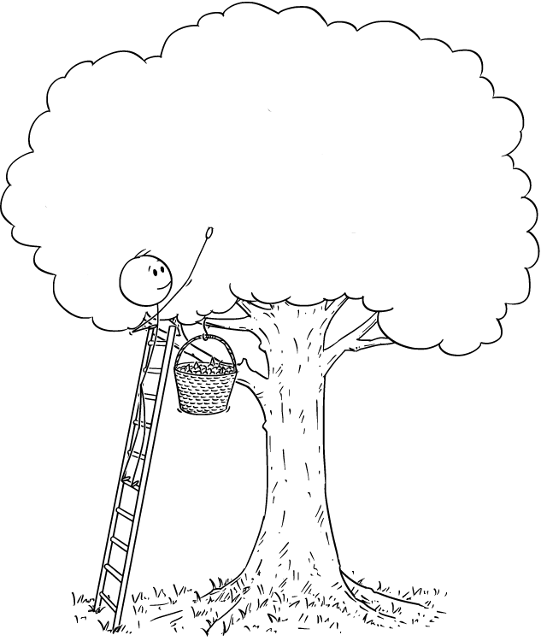
Multiplicity Control for Cherry-picking
Chen C, Li N, Yuan S, Antonijevic Z, Kalamegham R, Beckman RA. Statistical design and considerations of a Phase 3 basket trial for simultaneous investigation of multiple tumor types in one study. Statistics in Biopharmaceutical Research 2016; 8 (3): 248-257.
Zhou H, Liu F, Wu C, Rubin EH, Giranda VL, Chen C. Optimal Two-stage Designs for Exploratory Basket Trials, submitted.
Wu C, Liu F, Zhou H, Rubin EH, Giranda VL, Chen C. Optimal Design and Analysis of Efficacy Expansion in Phase I Oncology Trials, to be submitted.
Chen C, Zhou H, Li W, Beckman RA. How Many Substudies Should be Included in a Master Protocol? to be submitted.

Slide 9
Basket Designs with Cherry-picking
Prune inactive ones and pool active ones in the pooled analysis (pruning and pooling)
Type I error is controlled at target level under global null
Type II error is calculated under a non-informative prior for number of active tumors (i.e., uniform distribution)
Design parameters can be obtained similarly when an informative prior is available
Don’t rely on homogeneous assumption for analysis

Slide 10
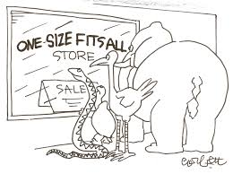
Fit-for-purpose
Fix power or sample size?
One or two-stage?
Same or different hypotheses?

Slide 11
A One-stage Design Example with Same Null/Alternative Hypotheses
Design of a 5-tumor basket trial with minimal sample size targeting (α, β)=(0.05, 0.20)
The sample size in the hypothetical trial is optimal
The clinical intuition of pooling tumors with ≥4 responses makes sense
The pooled data should be tested at α*=0.009
P0 | P1 | r | α* | n
0.10 | 0.25 | 4 | 0.009 | 25

Slide 12
Positive Outcomes in the Hypothetical Trial
The drug is deemed active based on hypothetical outcome (4+5+6=15 responses in 3 tumor cohorts)
However, it doesn’t mean all 3 tumor cohorts are active
# Tumors | Sample size | Min #resp | Min ORR
1 | 25 | 8 | 32%
2 | 50 | 12 | 24%
3 | 75 | 15 | 20%
4 | 100 | 19 | 19%
5 | 125 | 22 | 18%

Slide 13
A One-stage Design Example with Heterogenous Null/Alternative Hypotheses
Set-up for (H0, H1)
Mono in 3 tumor cohorts without SOC: (0.05, 0.2)
Combo with SOC in 2 tumor cohorts: (0.2, 0.35)
Design features
Each has comparable probability to be pooled
Minimum overall sample size to achieve the desired Type I/II error rates
Overall response rate in the pool is compared to H0 for the pooled tumor cohorts weighted by sample size

Slide 14
Design of the Hypothetical Trial
Design parameters at (α, β)=(0.05, 0.20)
Total sample size=3*18+2*34=122
Probability of pooling
(23%, 23%) under P0 for (mono, combo)
(90%, 89%) under P1 for (mono, combo)
P0 | P1 | r | n | α*
0.05 | 0.2 | 2 | 18 | 0.011
0.2 | 0.35 | 9 | 34

Slide 15
Examples of A Positive Outcome
Assuming there is one mono and one combo left in the pool (n=52=18+34)
#resp(%) to mono | #resp(%) to combo | Overall #resp(%) | Weighted ORR (H0) | P-value
2 (11%) | 13 (38%) | 15 (29%) | 14.8% | 0.0069
4 (22%) | 11 (32%)
6 (33%) | 9 (26%)

Slide 16
Two-stage Optimal Basket Designs
Design parameters of a two-stage 5-tumor basket trial with minimal sample size for same (P0, P1)=(0.1, 0.25) targeting (α, β)=(0.05, 0.20)
An extension of Simon’s two-stage designs for single arm trials to a multi-arm basket trials
N=43/40 under Simon’s designs for single arm trials
 | r1 | n1 | α* | n
Optimal | 2 | 9 | 0.019 | 33
Minimax | 3 | 18 | 0.009 | 25
Tumor cohorts with ≥r1/n1 responders will be pooled for analysis at end of second stage

Slide 17
Two-stage Design Under Fixed Sample Size
Remaining sample size for early-terminated tumor cohorts is evenly distributed to the continuing ones
Design parameters of a two-stage 5-tumor basket trial with minimal sample size for same (P0, P1) & (α, β)
Planned sample size per arm (n=20) is smaller than under the optimal design (n=33)
However, may have more patients in a remaining arm (e.g., n=35 if 3 arms were terminated in first stage)
r1 | n1 | α* | n
2 | 10 | 0.018 | 20

Slide 18
Comments
The basket designs based on pruning and pooling provide closed-form sample size estimates for planning purpose
Rejection of the global null means drug is active which paves the way for further investigation
RWE may be used to assist with GNG decisions in this dynamic era post immunotherapy revolution
Alternative endpoint to ORR and randomized controlled designs may be considered as appropriate
Various extensions under investigation (e.g., two-stage under heterogeneous hypotheses)

